Slide 1
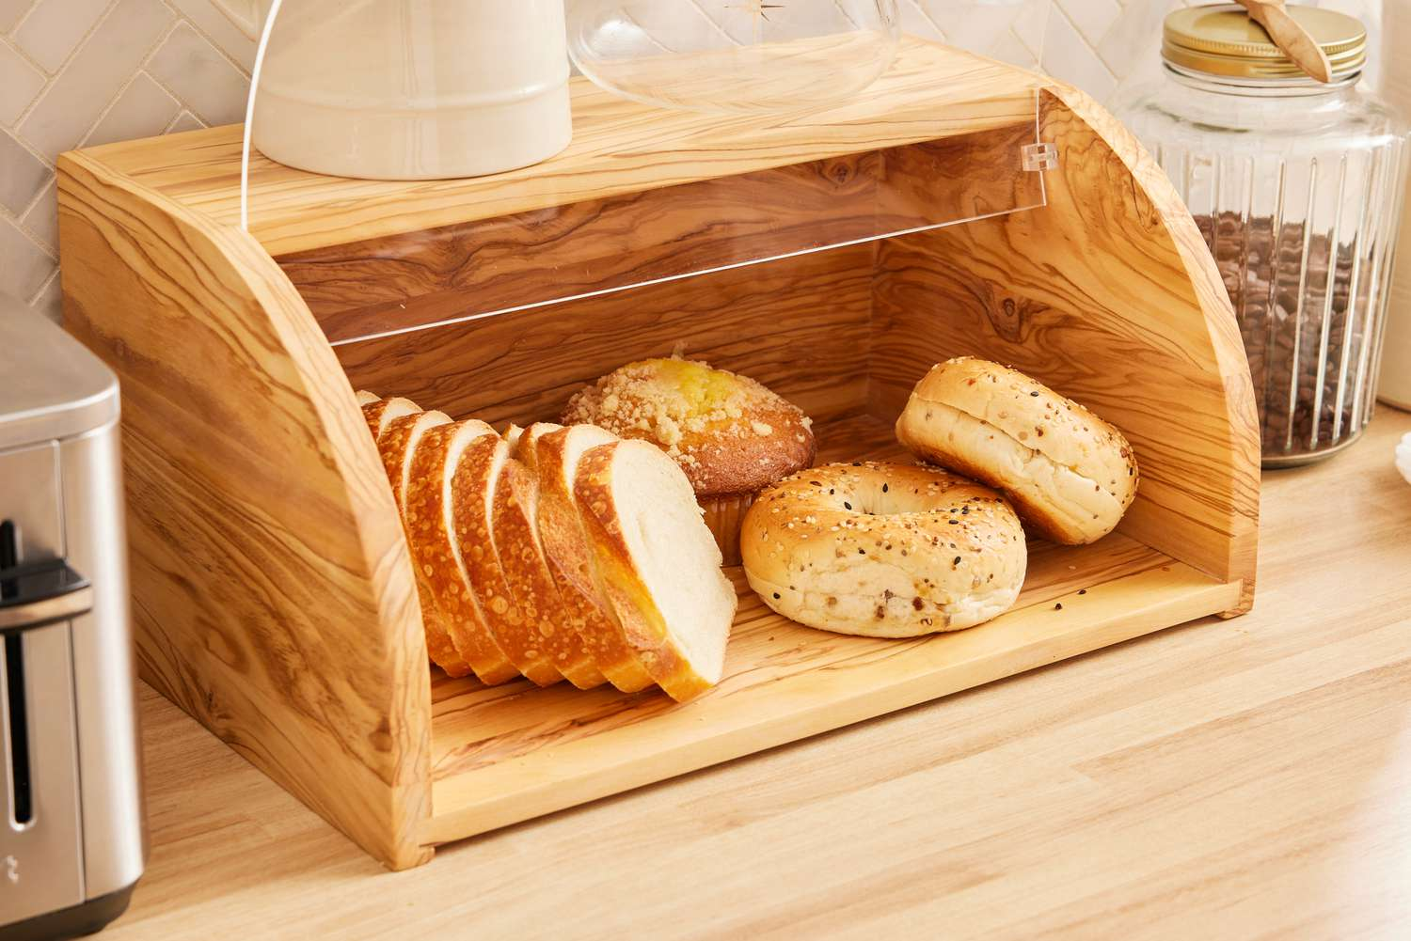
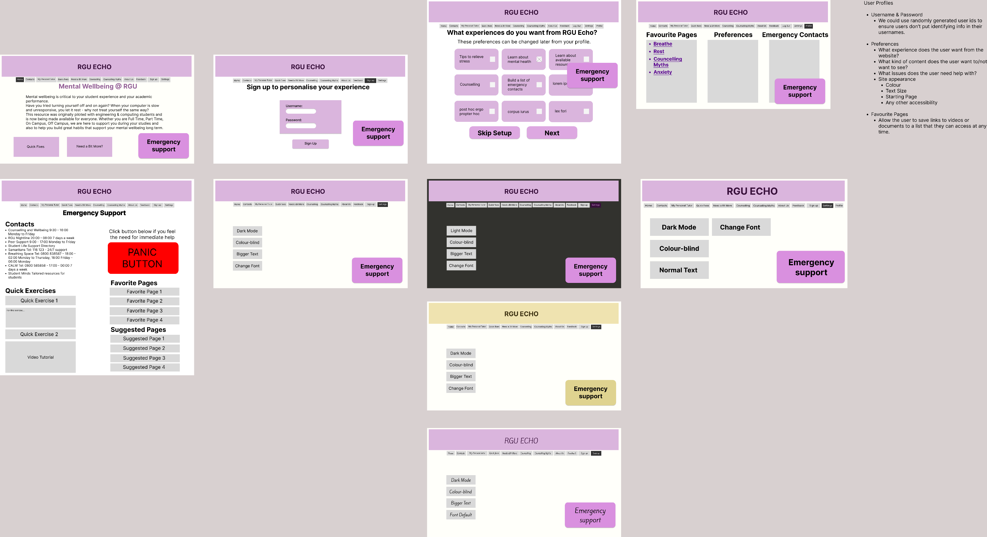

Breadbox
Client: Jo
Members: Emmanuel Friday Ugwu, Jack Thompson, Kieran Dingwall, Onyekachi Obiora, Ryan Jones, Stuart Lancaster
Collaboration & Interdisciplinary Teamwork
Client Brief
Created to address and help the mental health of students at RGU, Echo originally provided resources to help engineering and computing students but is now open to everyone who needs it. Echo provides exercises designed to help students, such as breathing exercises, and provides help for other issues ranging from anxiety and depression to issues with addiction or problems with sleep. There are also pages about counselling, and contacts for help.
figures
Vitam voloria con et, cum laboreium, nam cum, quat paris as core volorest, sust exceatur antio ea voluptas eumquatendit quas doluptatet aut landignam que lantur sania dem escidit min reruptiaero velis maximus aut que pe aliquas sequidisit, omnient hit lam eicias modio con nisin pediam, ent, cust accaborit odio corehen dendae nonet eliquam, aperorepe autatem voles int odic tem nis dolorrum que cores doluptaturi utemolorum imusam, idendaecabo. Nam quo moluptatur?
eicias modio con nisin pediam, ent, cust accaborit odio corehen dendae nonet eliquam, aperorepe autatem voles int odic tem nis dolorrum que
Vitam voloria con et, cum laboreium, nam cum, quat paris as core volorest, sust exceatur antio ea voluptas eumquatendit quas doluptatet aut landignam que lantur sania dem escidit min reruptiaero velis maximus aut que pe aliquas sequidisit, omnient hit lam eicias modio con nisin pediam, ent, cust accaborit odio corehen dendae nonet eliquam, aperorepe autatem voles int odic tem nis dolorrum que cores doluptaturi utemolorum imusam, idendaecabo. Nam quo moluptatur?
figures
figures
The project is still in its early stages though, and Jo is looking to continue expanding the app. Among the ideas presented for expanding and improving the site, the accessibility of it as well as its security stood out as the most important things that we should be looking at to tackle.
Technical Details
Our protype was developed using Figma. We based it on the already existing Wix site for Echo, and one of our priorities was trying to stay as faithful to the original design as possible. We didn’t want to over complicate things
Implemented Solution
As verepe sectis enda di incto etusda delectet eaque simusda ndanimus, sin cori rem id maximillut hari con ea quiam quam et enduci idunt, corecta alicimp oriaeperum iusaeped unt quis et ut abor ame alis utatur as senet a quibus dolutatur sedit aliam apienda versper feriti delia pa dolo quamus arum es endellu pisquia aditatur audam earupid quo quunt odigniscil earum verios nonsequam duciis et apienda versper feriti delia pa dolo quamus arum es endellu pisquia aditatur audam earupid quo quunt odigniscil earum verios nonsequam
Once we had agreed upon the areas we should be focusing on, we conducted research on accessibility features as well as cyber security before coming together and developing a prototype of what these new features could look like.
With work on the prototype complete, we showed it to our client and then took her feedback to create some web pages to better show what these features could look like.
Conclusions & Future Plans
Vitam voloria con et, cum laboreium, nam cum, quat paris as core volorest, sust exceatur antio ea voluptas eumquatendit quas doluptatet aut landignam que lantur sania dem escidit min reruptiaero velis maximus aut que pe aliquas sequidisit, omnient hit lam eicias modio con nisin pediam, ent, cust accaborit odio corehen dendae nonet eliquam, aperorepe autatem voles int odic tem nis dolorrum que cores doluptaturi utemolorum imusam, idendaecabo. Nam quo moluptatur? aut omnienderi sinvele stiam, cus eos sime sed que occupta temquia nobisciur? Quis dolenem oluptam ne nonessumqui. Vitam voloria con et, cum laboreium, nam cum, quat paris as core volorest, sust exceatur antio ea voluptas eumquatendit quas doluptatet aut landignam que lantur sania dem escidit min reruptiaero velis maximus aut que pe aliquas sequidisit, omnient hit lam eicias modio con

